Slide 1
Content:
Training kit for the Game implementation for secondary school pupils
Pregame competences evaluation

Slide 2
Gamer types
Who you are?

Slide 4
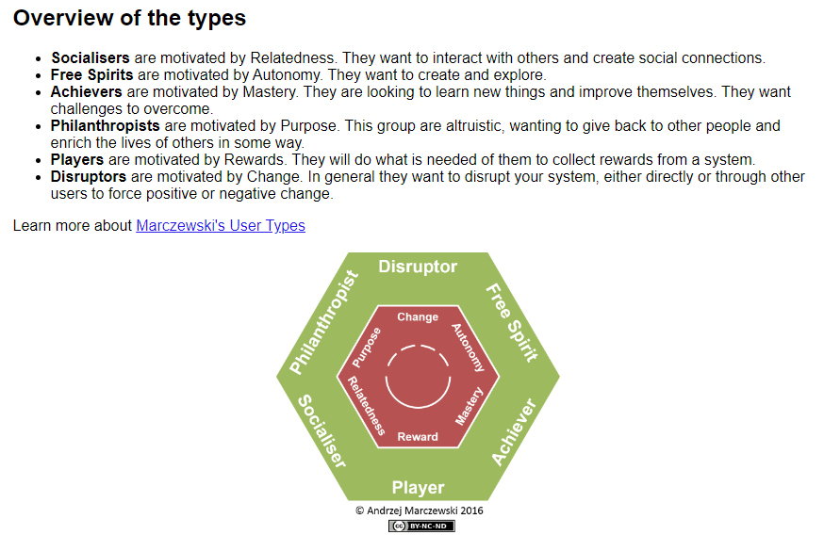
Exercise 1 - find your gamer type
Open up the website https://gamified.uk/UserTypeTest/user-type-test.php?lid=
Take the test and learn who you are!
Compare yourself to others
Discuss!

Slide 5
Types of games

Slide 6
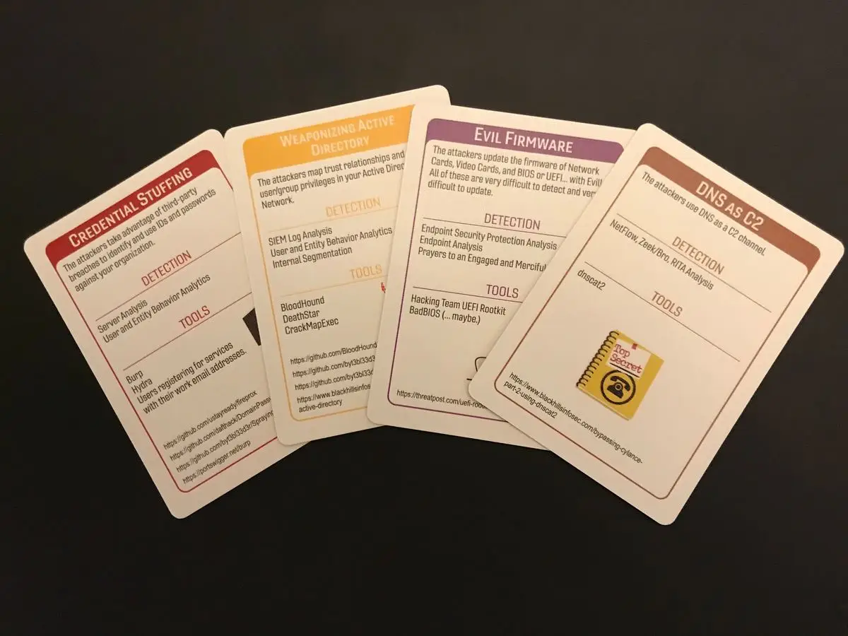
Cyber games
Tests (like in schools)
Card Games/Tabletop games
Video Games
CTF games
Puzzle
Attack-Defense games
Real Simulation attacks or OSINT challenges
What kind of games you have seen, heard or experienced before?

Slide 7
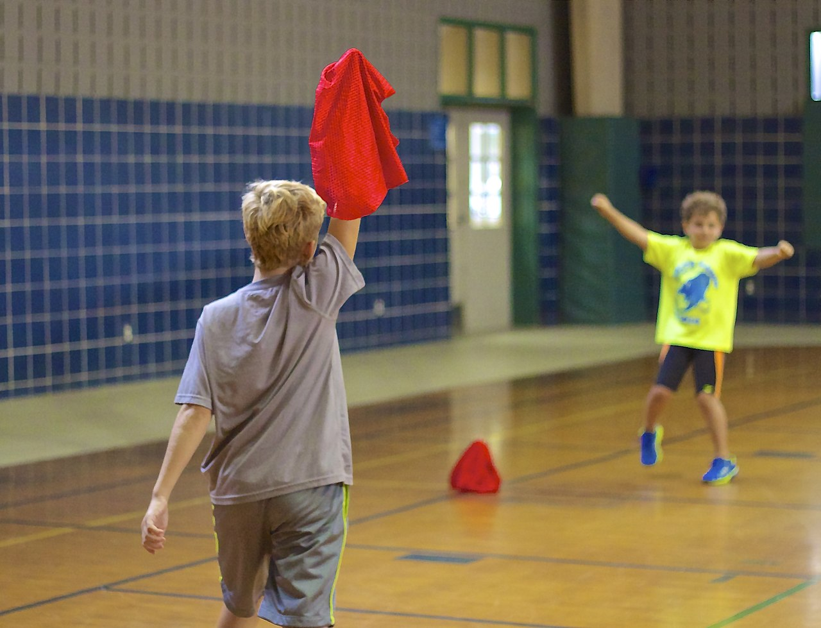
Term: CTF
Capture the flag (CTF) is a traditional outdoor sport where two or more teams each have a flag (or other markers) and the objective is to capture the other team's flag, located at the team's "base", and bring it safely back to their own base. Enemy players can be "tagged" by players in their home territory and, depending on the rules, they may be out of the game, become members of the opposite team, sent back to their own territory, or frozen in place ("in jail") until freed by a member of their own team.
https://en.wikipedia.org/wiki/Capture_the_flag

Slide 8
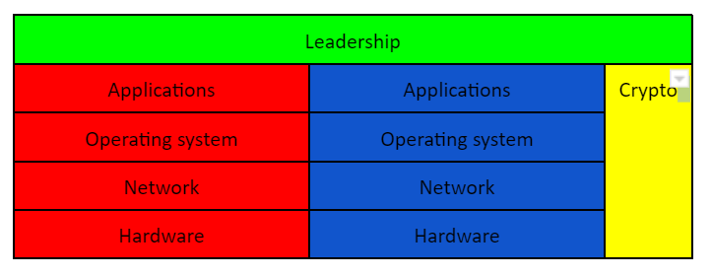
Exercise 2 - think of what kind of role you would like to take on the game?
Make a list of 3 potential roles that relate your competence and interest.
A LEADER OF PEOPLE
ADMINISTRATOR (DEFENDER)
THE SCRIPTER
PENTESTER (ATTACKER)
HARDWARE WEAKNESS FINDER
CRYPTOGRAPHER
What do you think these roles do and mean?
What does RED or BLUE team do?

Slide 9
European Cyber Security Challenge

Slide 10
What you need to
be part of Capture the Flag competitions?

Slide 11
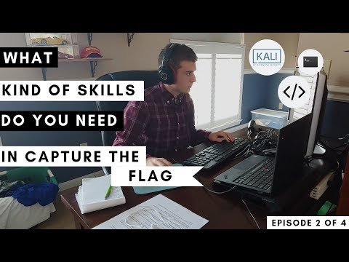

Slide 12
CTF starting materials and portals to learn (easy level)
Hack This Site!
https://www.hackthissite.org/
Reversing.kr
http://reversing.kr/
Cybrary
https://www.cybrary.it/catalog/
Damn Vulnerable Web App
http://www.dvwa.co.uk/
OWASP Top Ten
https://www.owasp.org/index.php/Category:OWASP_Top_Ten_Project
OWASP Juice Shop
https://www.owasp.org/index.php/OWASP_Juice_Shop_Project
Live Overflow
http://liveoverflow.com/index.html
Hacker Experience
https://legacy.hackerexperience.com/
PHP Security Calendar 2017
https://www.ripstech.com/php-security-calendar-2017/
AttackDefense
https://attackdefense.com/
NITE Team 4 (payd access)
https://store.steampowered.com/app/544390/NITE_Team_4/
hackmud (payd access)
https://store.steampowered.com/app/469920/hackmud/
RingZer0 CTF
https://ringzer0ctf.com/challenges/
PentesterLab Bootcamp
https://pentesterlab.com/bootcamp
Google 2018 CTF: beginners
https://capturetheflag.withgoogle.com/#beginners/
W3Challs
https://w3challs.com/challenges/
Hellbound Hackers
https://www.hellboundhackers.org/
hack.me
https://hack.me/explore/
HackThis!
https://www.hackthis.co.uk/
Enigma Group
https://www.enigmagroup.org/
Google Gruyere
http://google-gruyere.appspot.com/
Game of Hacks
http://www.gameofhacks.com/
Project Euler
https://projecteuler.net/about
CryptoPals
http://cryptopals.com/

Slide 13
Where to find CTF-s
Locate your country event organizer from https://ecsc.eu/
or international: https://ctftime.org/

Slide 14
Next learn about
Cyber4Schools game scenario and
how to play Cyber4Schools

