Slide 1
Content:
Training kit for the Game implementation for secondary school pupils
CyberSecurity in EU
Cyber security theoretical material
Pregame competences evaluation

Slide 2
CyberSecurity in EU and learning possibilities

Slide 3
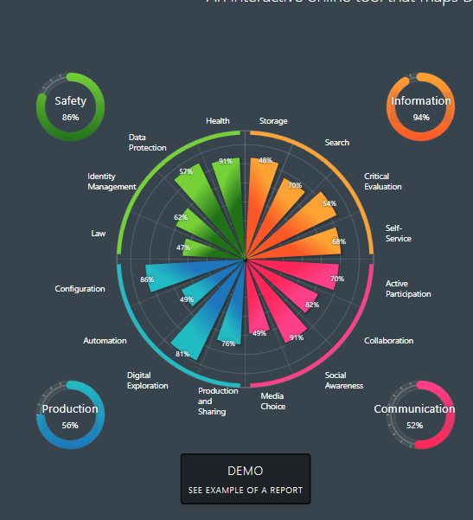
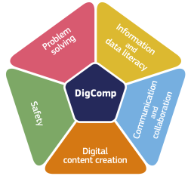
Digital Competence Model in EU
EU has agreed for the citizens that everyone must know the basic how to act as a digital society member.
Take a self-evaluation a test to learn where you are good and where you are not as a commoner: https://digital-competence.eu/
Areas:
Information
Communication
Safety
Production
Is this enough?

Slide 4
Schools and industry expectations for the students
Results from the teachers study show: Importance Topics to teach in CS
High - Trending topics in CS, psychological aspects, information society, responsible use of IT, Fake news, social media safety, passwords, PC use, Website hacking, network hacking
Average - Cybercrime, security as a career option, Competence evaluation, OSINT, mental and physical health, digital society culture, regulations, and law, GDPR, economy, ethics, online servers use, reverse engineering, coding, IoT, Crypto
Low - Linux, forensics, hardware issues
In reality that cyber security industry needs is vice versa.
Discuss: What do you think it is in this way? Does the students expectation differ from teachers? How?

Slide 5
Questions for self-evaluation regarding cyber security: no, rather no, rather yes, yes
1. Have you done self-evaluation tests around your cyber security skills and gaps? Give an example.
2. Do you follow cyber security related news, youtubers etc. Give an example of who and on what topics.
3. Have you taken a special course of cyber security at my school (curricular or extracurricular)? Give example.
4. Do you have friends or family that are fans of ICT and cyber security? Who?
5. Do you discuss cyber security issues with your friends? Give examples on what topics.
6. Have you visited Cyber security related vocational school or university introductory events? Give examples.
7. Have you visited an IT or cyber security company? Give examples.
8. Do you learn about cyber security on your own in your free time? Explain how?
9. Have you been part of cyber security training, competitions (CTF), boot camps? Give examples.
10. Other you want to mention about your cyber security interest

Slide 6
Cyber Security Basics

Slide 7
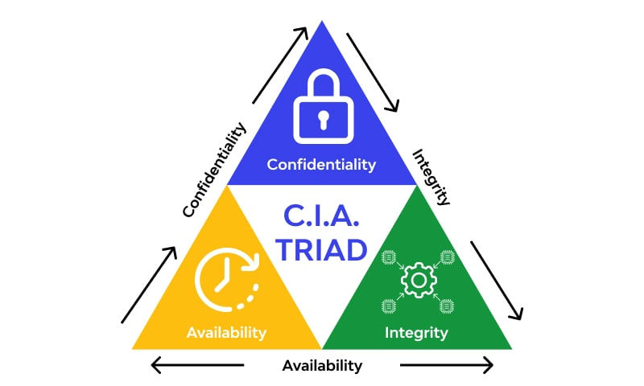
CIA triad
Give example of
in a School about
Confidentiality
Integrity
Availability

Slide 8
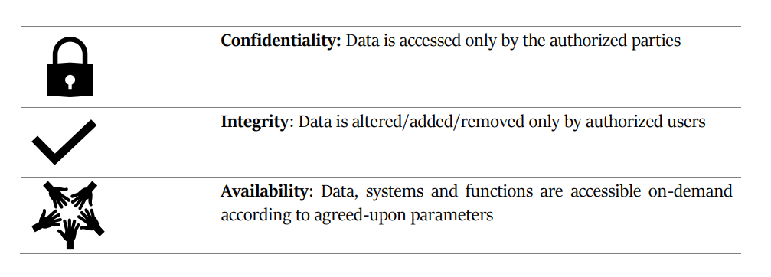
Answer:

Slide 9
Terminology - you can “Google” and let's discuss!
What is the difference between digital safety/security and cyber security?
What means in cyber security:
Network
Operating systems and Virtual Machines
Client machines
Vulnerability
Cyber Threat

Slide 10
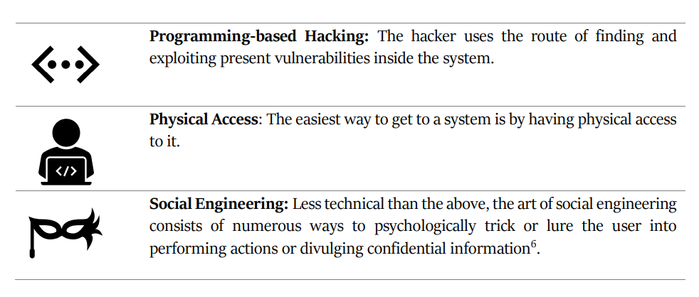
Attack types

Slide 11
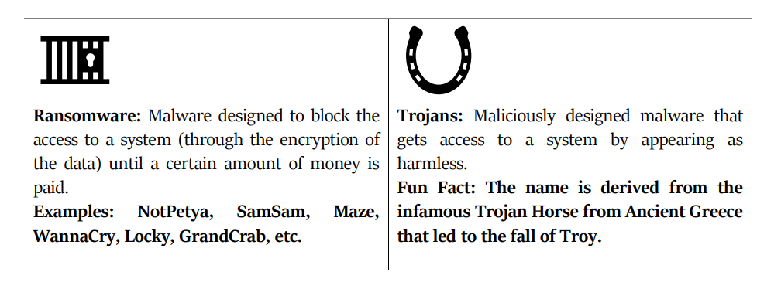
Malware

Slide 12
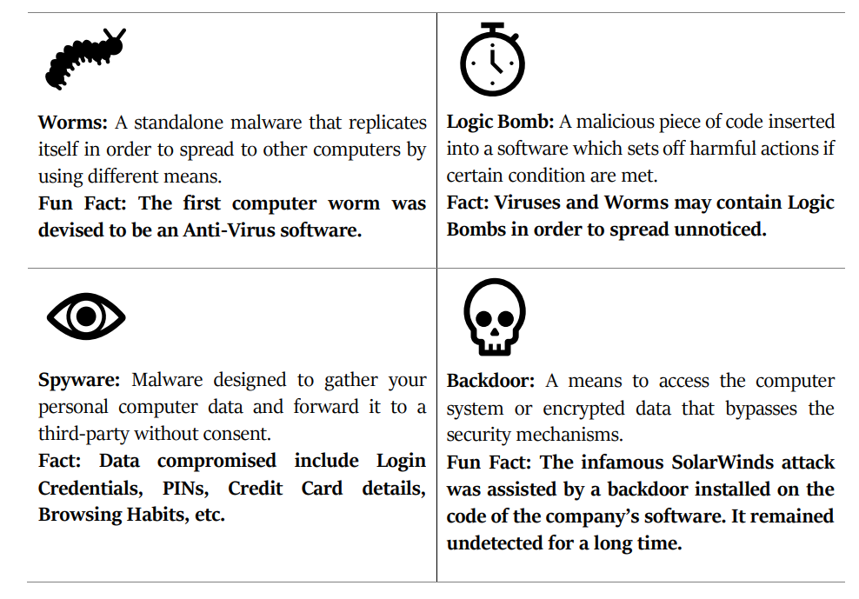

Slide 13
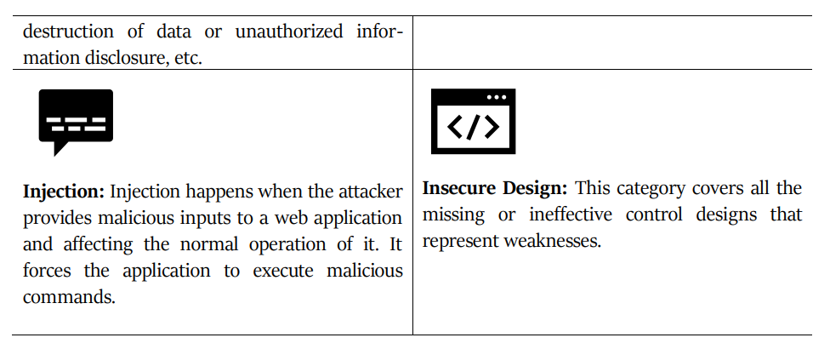
Application
hacks

Slide 14
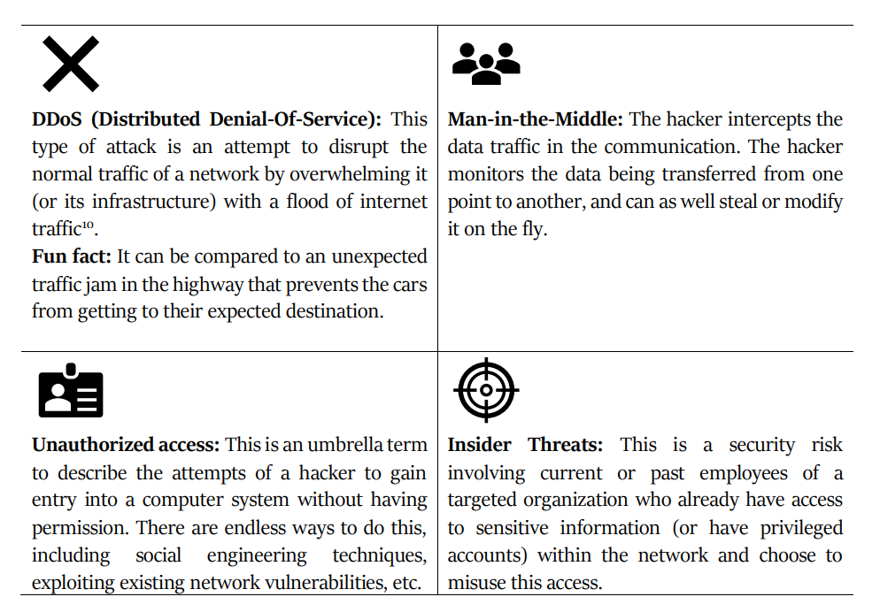
Network hacks

Slide 15
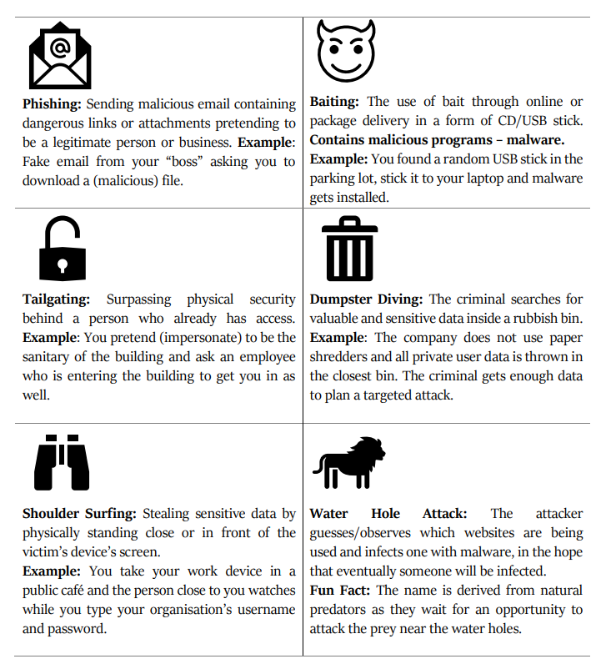
Social engineering

Slide 16
Windows security tips

Slide 17
Linux for beginners

Slide 18
Linux for Hackers

Slide 19
Attack Mechanisms and Security Measures
Reconnaissance
Threat Modelling and Vulnerability Identification
Gaining Access (Exploitation)
Post-exploitation
Endpoint Protection
Hardening
Password Policy
Security Awareness Training
Share real life examples of all of these items - what you have seen or experienced.

Slide 20
Actors in cyber realms

Slide 21
Who is who?
Notes:
“white hats” are those who do good things. Their goal is to find security bugs in the system and report them or fix them. They are also called ethical hackers.
"gray hats" are those who, depending on the situation, can do so much good or can also act for their own benefit, i.e. if, for example, when a security error is discovered, it is possible to get a benefit for it, they will definitely take it out.
“black hats” or "backhats" are characters who have rather evil motives and are feared because their goal is only self-interest and doing harm to others.

Slide 23
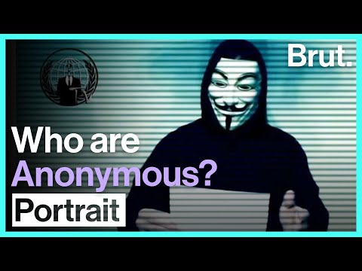

Slide 24
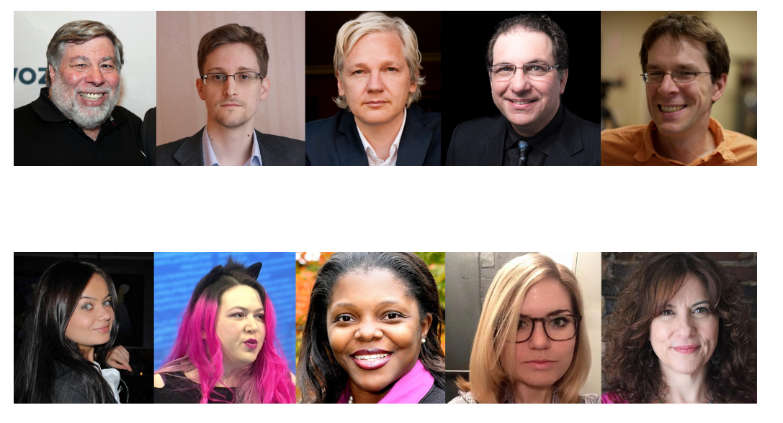
Who is who? (use Wikipedia to learn)

Slide 25
Next
Pregame competences

