Slide 1
Content:
Training kit for the Game implementation for secondary school pupils
Scenarios available
Game environment for teachers
Game environment for students
Scenarios under development

Slide 2
Scenarios
For storyline see x file!

Slide 3
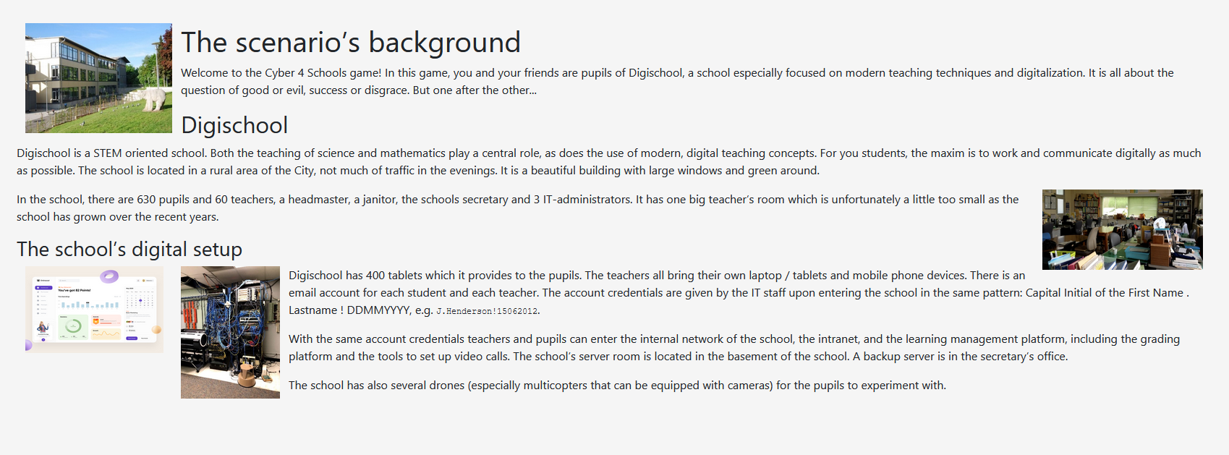
Story of the game

Slide 4
Episode 1
Episode 1: Phishing
1) General Tasks for Blue Team
è The blue team’s task should be to inspect the e-mail arrived and think about try to find different hints. Which of the things could have been done better? They will learn about phishing e-mails and then put their knowledge to test.
2) General Tasks for Red Team
è The red team’s task should be to inspect the e-mail arrived and think how to use some of the information they found to sabotage one or several other participating teams and thereby give themselves a possible advantage. They will learn about phishing e-mails, try to prepare one and then test it on their own machine.

Slide 5
Episode 2
Episode 2: Malware
1) General Tasks for Red Team
è The red team’s task should be to work on a simple malicious file. In order to remain ethical, the Reds will edit and run the (safe) malicious file on their machine to understand the consequences. They will learn more about ransomware, as well as, something speacil called encoding.
2) General Tasks for Blue Team
è The blue team’s task should be understand whether or not they were part of a malware infection by analyzing the damaged files and the possible decryptor. Will they be able to get their precious files back?

Slide 6
For teachers
How the environment looks like

Slide 7
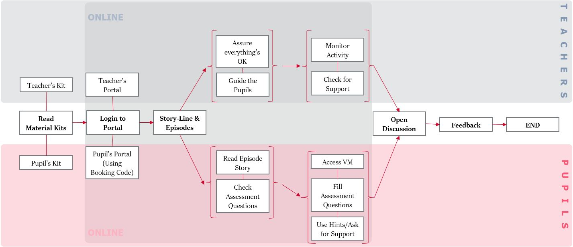
How to play the game with students?

Slide 8
Website and credentials https://portal.cyber4schools.org
For teachers - log in as teacher
The basic workflow that can be followed, would be:
Book an Time under SCENARIOS!
This should now be visible under BOOKINGS. From here you can also get to the Lobby of a scenario. You can then choose a scenario or change it.
At this point students will be able to join a scenario using the ‚Ticket No‘ that is shown in the Lobby.
To see this you can use a new Browser Window (or Instance) and Login as a team with a team name of you choice and the Ticket-No that you got from the booked scenario.
On the teachers side you will then see the lobby filling up according to the number of students that joined.
Now the teacher should assign red/blue teams for all members.
If this is done and the booking time has been reached, the scenario can be started from the lobby by the teacher.

Slide 9
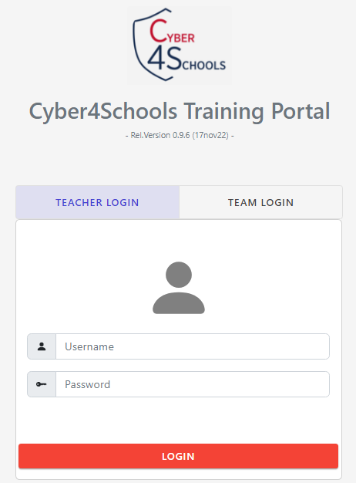
Log in as a teacher
Credentials will be given by:
Poland – l.wilczynski@asmresearch.pl (Łukasz Wilczyński)
Estonia – birgy.lorenz@ttu.ee (Birgy Lorenz)
Germany – f.brackhane@uniss.org (Fabian Brackhane)

Slide 10
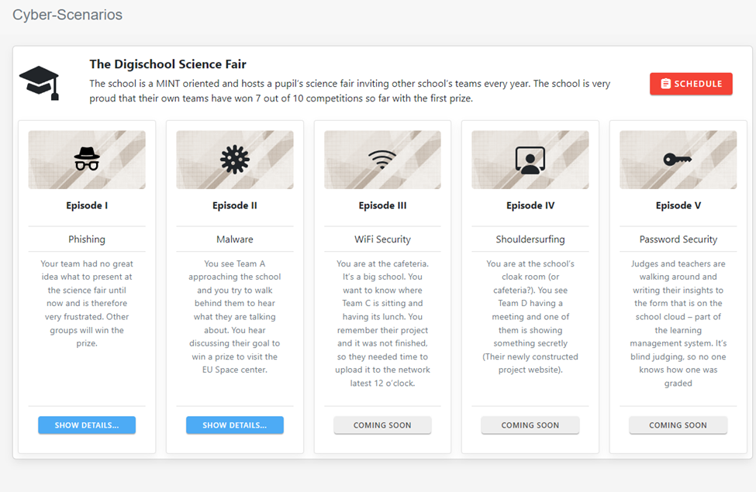

Slide 11
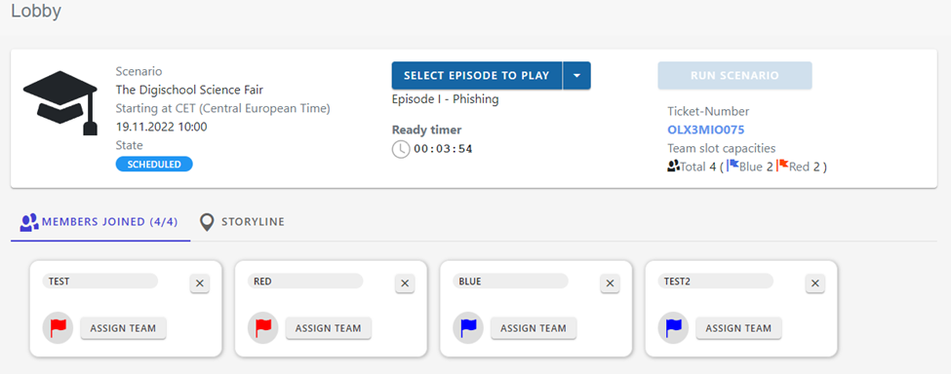

Slide 12
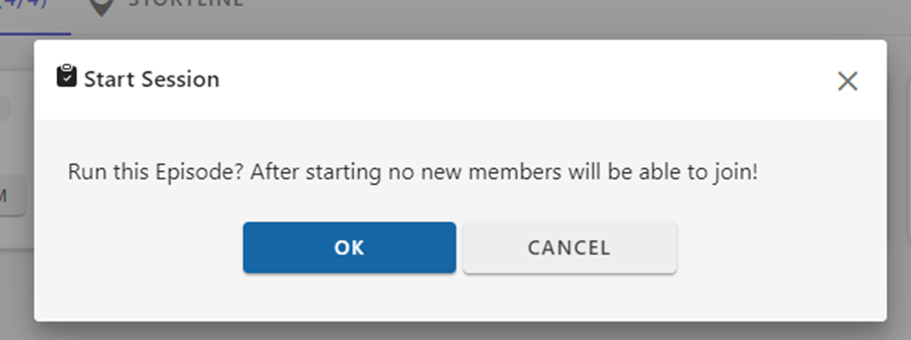
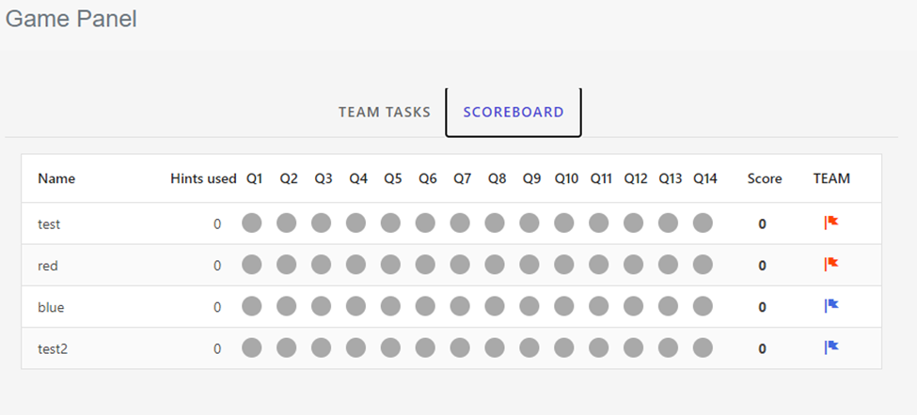
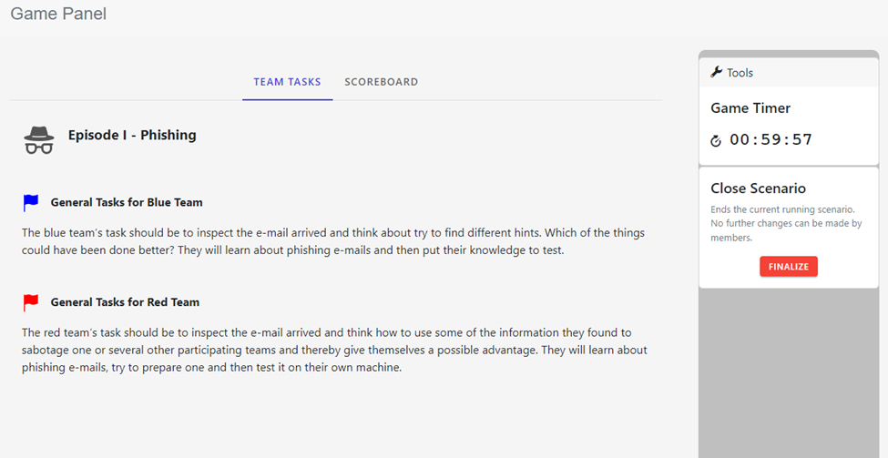
For teachers panel, you see these info about your students performance:

Slide 13
For the students

Slide 14
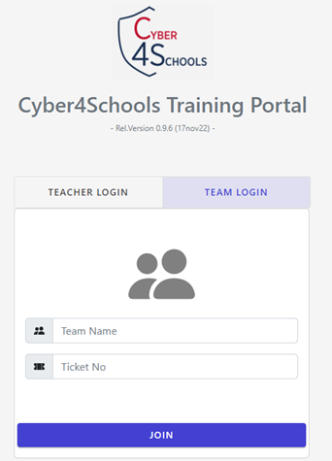
Website and credentials https://portal.cyber4schools.org
Teacher will give you a ticket nr.
Don't close the website!
Teacher will assign your role and launch the game!
Then you can join the game.

Slide 15
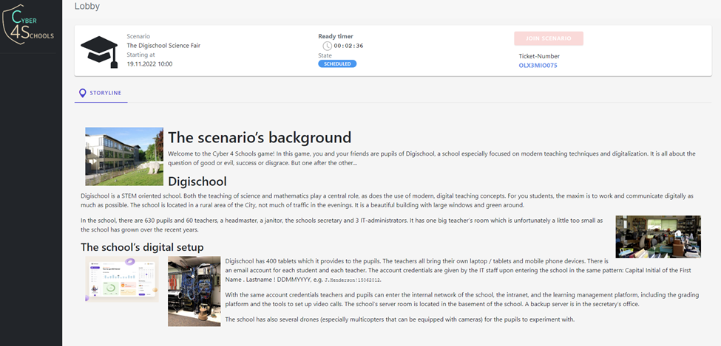

Slide 16
Information before the game

Slide 17
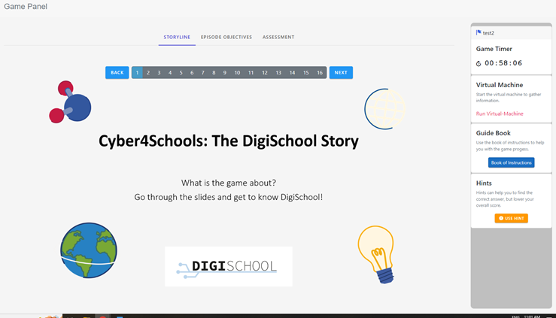
Read the storyline

Slide 18
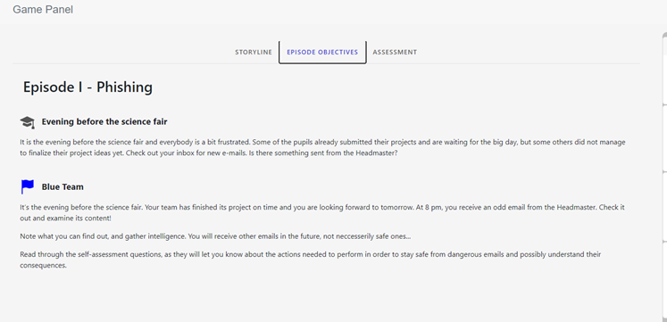
Objectives

Slide 19
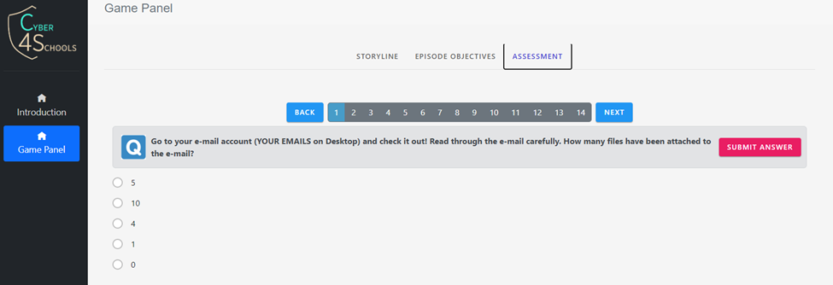
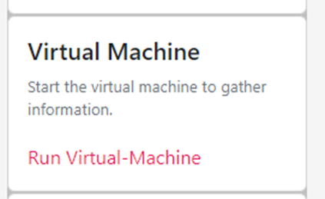
Assessment and exercises
To find answers open up the virtual machine!

Slide 20
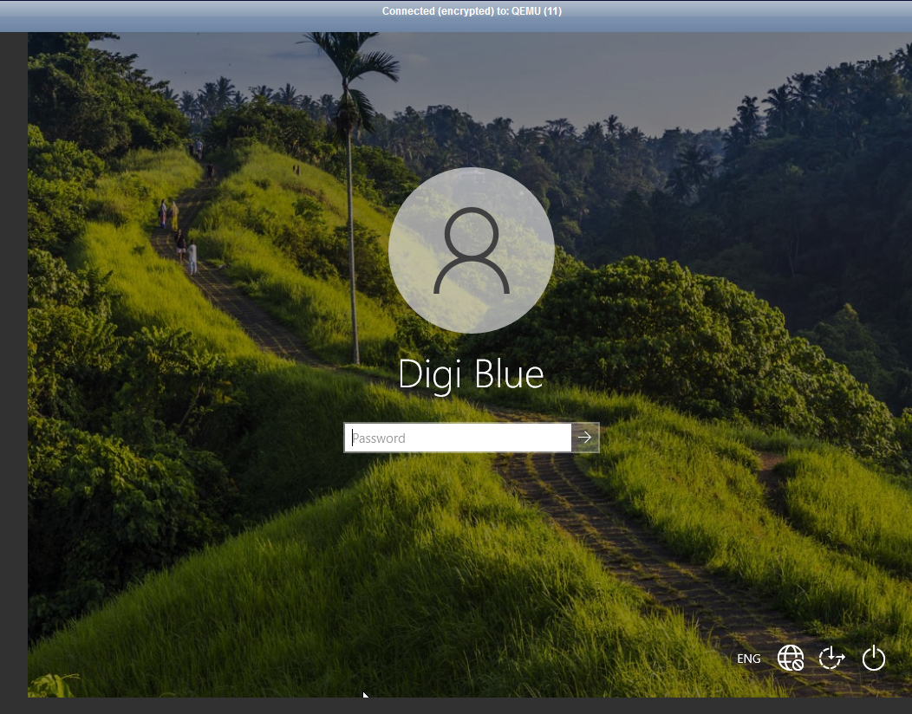
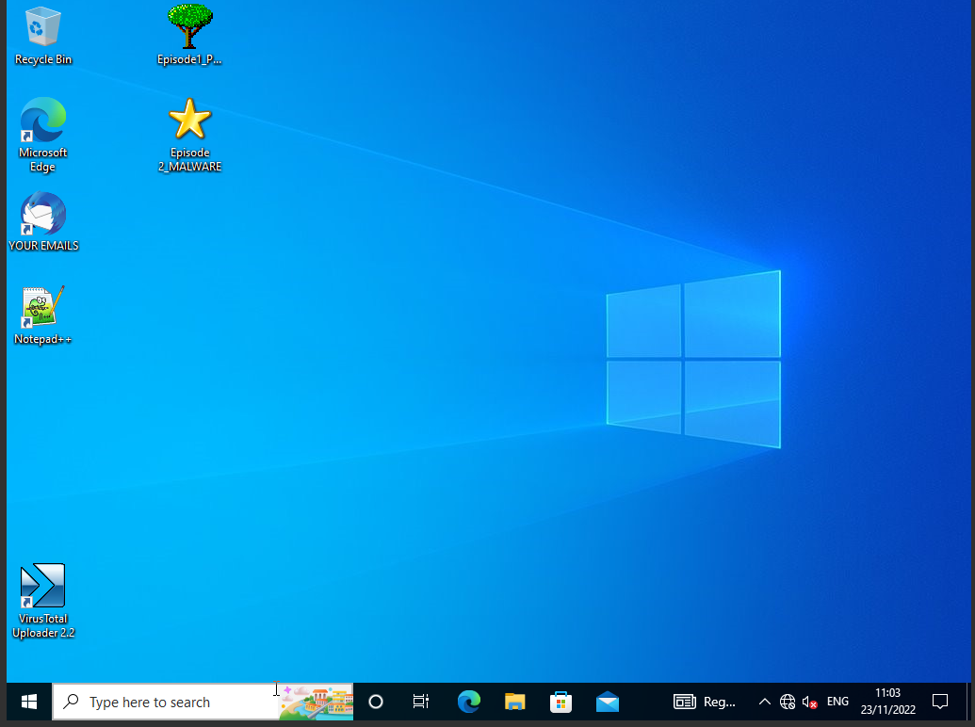
Virtual machine: Windows

Slide 21
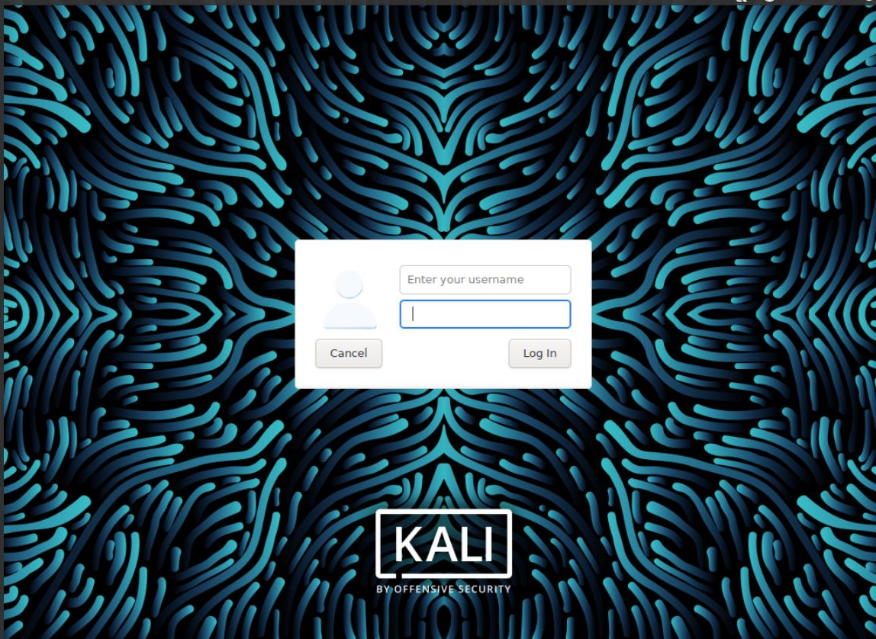
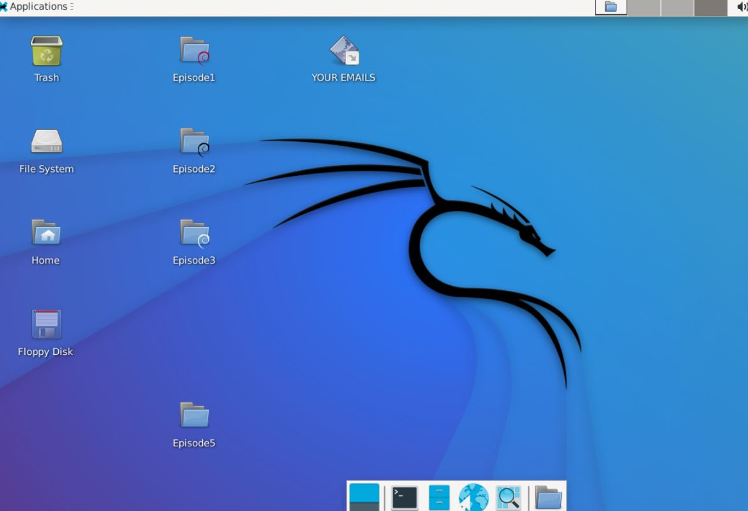
Virtual machine: Linux

Slide 22
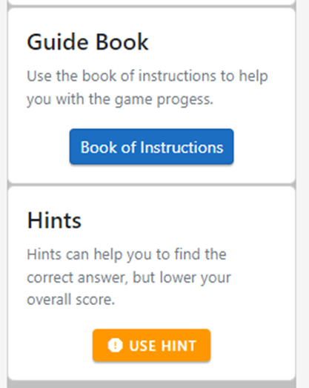
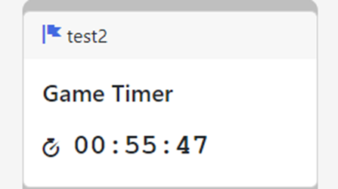
Additional help
You can also take hints!

Slide 23
Scenarios under development
3. WiFi security
4. Shoulder Surfing
5. Password security

