Slide 1
Cyber4Schools: The DigiSchool Story
What is the game about?
Go through the slides and get to know DigiSchool!

Slide 2
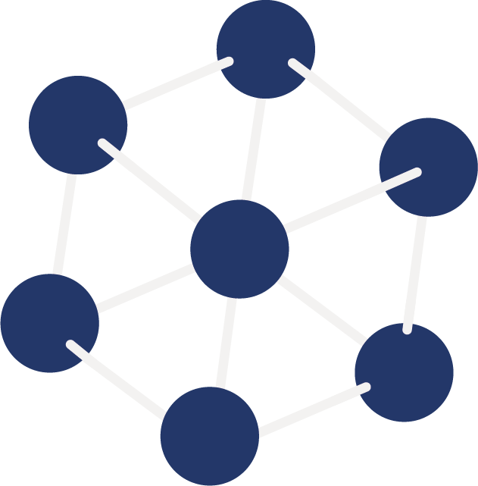
The scenario’s background
Welcome to the Cyber 4 Schools game!
In this game, you and your friends are pupils of Digischool, a school especially focused on modern teaching techniques and digitalization. It is all about the question of good or evil, success or disgrace.
But one after the other...

Slide 3
Get to know the Digischool
Digischool is a STEM oriented school. Both the teaching of science and mathematics play a central role, as does the use of modern, digital teaching concepts. For you students, the maxim is to work and communicate digitally as much as possible. The school is located in a rural area of the City, not much of traffic in the evenings. It is a beautiful building with large windows and green around.

Slide 4
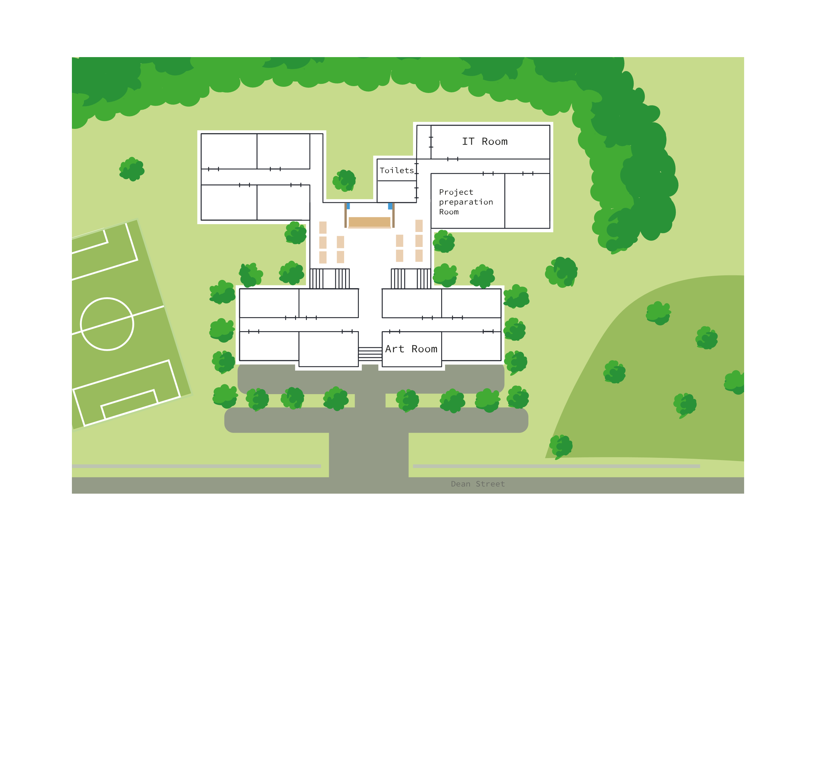
Digischool
In the school, there are 630 pupils and 60 teachers, a headmaster, a janitor, the schools secretary and 3 IT-administrators. It has one big teacher’s room which is unfortunately a little too small as the school has grown over the recent years.

Slide 5
The school’s digital setup
Digischool has 400 tablets which provides to the pupils. The teachers all bring their own laptop / tablets and mobile phone devices. There is an email account for each student (or student groups) and each teacher.
The account credentials are given by the IT staff upon entering the school in the same pattern: Capital Initial of the First Name . Lastname ! DDMMYYYY, e.g. J.Henderson!15062012

Slide 6
The school’s digital setup
With the same account credentials teachers and pupils can enter the internal network of the school, the intranet, and the learning management platform, including the grading platform and the tools to set up video calls. The school’s server room is located in the basement of the school. A backup server is in the secretary’s office.
The school has also several drones (especially multicopters that can be equipped with cameras) for the pupils to experiment with.

Slide 7
The Digischool Science Fair
For many years now, the school hosts a pupil’s science fair every year, inviting teams from other schools of the region. This year’s fair is just coming up tomorrow. In the afternoon, the exhibits and ideas of the participating student groups will be judged by a jury consisting of teachers from the participating schools, and prizes will be awarded.
Digischool is very proud that 7 out of 10 competitions so far have been won by one of their teams…

Slide 8
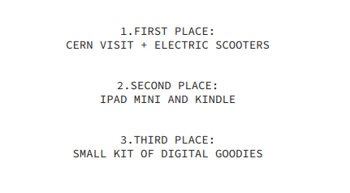
The Digischool Science Fair
The science fair meanwhile has gained much attention also outside the school; even business companies observe it closely to attend to scout young talents and thus the awards became very attractive.

Slide 9
The Digischool Science Fair
This year’s science fair was even announced in the local media and 10 teams already registered to take part, 3 of which are teams of Digischool (teams „Spaceship27”, „Flumes”, and „Fossils”).
All three teams are made up of talented and motivated students. Since the teams have formed themselves, it is hardly surprising that these three groups of students are homogeneous within themselves but different among themselves at the same time…

Slide 10
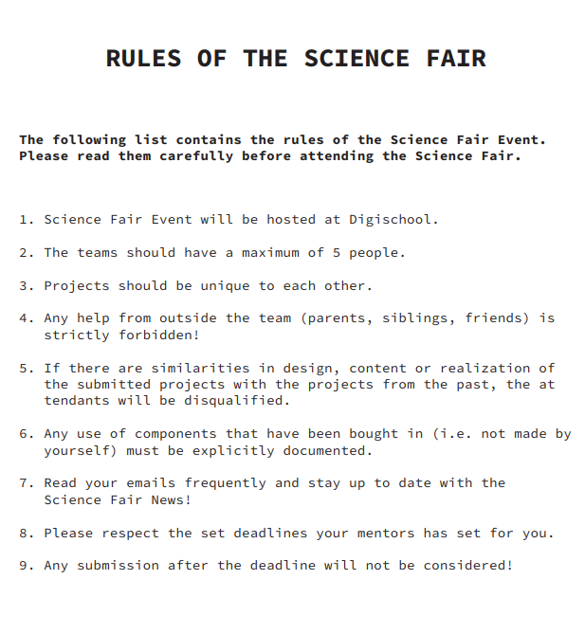
The Digischool Science Fair
Rules for the science fair are as clear as they are strict. They may get updated, so you should always check your email…

Slide 11
The Digischool Science Fair
The members of this year’s Spaceship27, referred to as Team A for easiness, have already won the prize last year and it is clear that this team is made up of the brightest minds of the school. The headmaster is very proud and said in an interview in the local media that he very much expects this team to win this year’s science fair as well. Team A finished their project work in time and they know how good they are. Since they finished everything early, they now have time to curiously observe the work of their competitors.
Of cours they are aware that not everybody would like to see them win again…

Slide 12
The Digischool Science Fair
They would also trust some of their competitors not to make fair play. Team Fossils, referred to as Team C for easiness, also seems to have a good idea of what they want to present at the fair, but they seem to be more relaxed about the whole thing than team A, not so annoyingly ambitious...

Slide 13
The Digischool Science Fair
Flumes, referred to as Team B, on the other hand, hasn't gotten beyond vague ideas throughout the preparation period. Its members have less interest in biological or chemical topics, but they are all very enthusiastic about computers. So they have much preferred to spend their preparation time searching the school network for hidden areas they could penetrate.

Slide 14
The Digischool Science Fair
Now, shortly before the fair actually takes place, frustration is spreading among them. They realize how much they would have liked to win the prize and go to CERN. Feverishly all of them are thinking about how they can turn things around at the last moment and not blame themselves at the presentation of the projects the next day. Also, they, too, have witnessed the headmaster's remarks.
Wouldn't it be a nice surprise if the nerds from team A surprisingly failed?
The stupid headmaster would make quite eyes how much he was wrong....

Slide 15
The Teams – Where do you belong?
In the game, you will act either as Team A – called the "blue team" – or as Team B – "red team". So your task will either have to protect yourself against possible intrigues and acts of sabotage or, on the contrary, to think up exactly such measures with which you could harm your opponents and perhaps still win the competition yourself.

Slide 16
The Teams – Blue vs Red
BLUE TEAM | RED TEAM
Team A at the DigiSchool Science Fair. You did come up with a very good idea already at an early date which will supposedly win the competition. You are aware that other teams might use unfair methods to win the competition because the first prize is so fantastic this year… | It’s team B at the DigiSchool Science Fair. You did not come up with an idea that did really work out in the end. So, you are very frustrated with the competition and the competition rules. Now you are seeking to do anything to sabotage it or find out about other‘s projects by force and use it for your own benefit.

